Slide 1
Exchange Visitor Services
Initial Request for a J1 Professor, Research Scholar or Short-Term Scholar

Slide 2
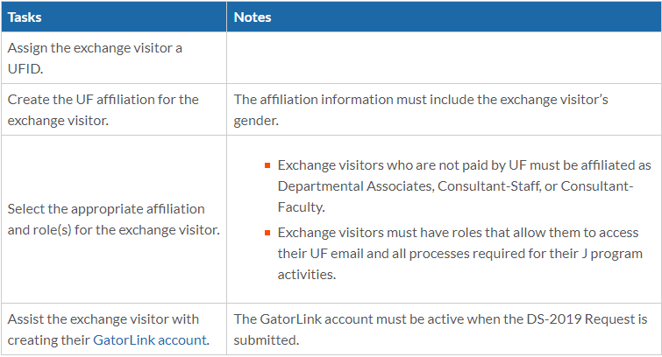
Before the Initial Request
Before you submit the request, EVS would like the department to have the following tasks done:
* Side Notes *
Make sure the exchange visitor can access and respond to their UF email
The department personnel will need to get access to UFIC’s system to submit the initial request. Let a J1 advisor know if you need access.

Slide 3
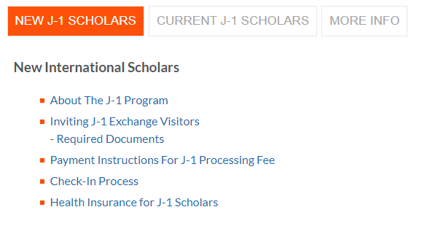
Submitting Initial Request
To start the process to submit an Initial Request, you will want to go to EVS website: https://internationalcenter.ufl.edu/j-1-studentscholar/j-1-scholars
You will want to go down the page to the New J-1 Scholars section and click on the Inviting J-1 Exchange Visitors.

Slide 4
Submitting Initial Request Cont.
On this page you will see a section on the page that has clickable tabs that says:
DS-2019 Request – This will have all the information about what needs to be done and the link to login and start the submission process.
Processing Information – This will have all the information about the average processing time and information about the next steps the exchange visitor will need to do once they get their DS-2019.
*For the Required Documents, there will be a link further down the page* Required Documents will have all the information and templates for the required documents you will need to upload in the submission process.

Slide 5
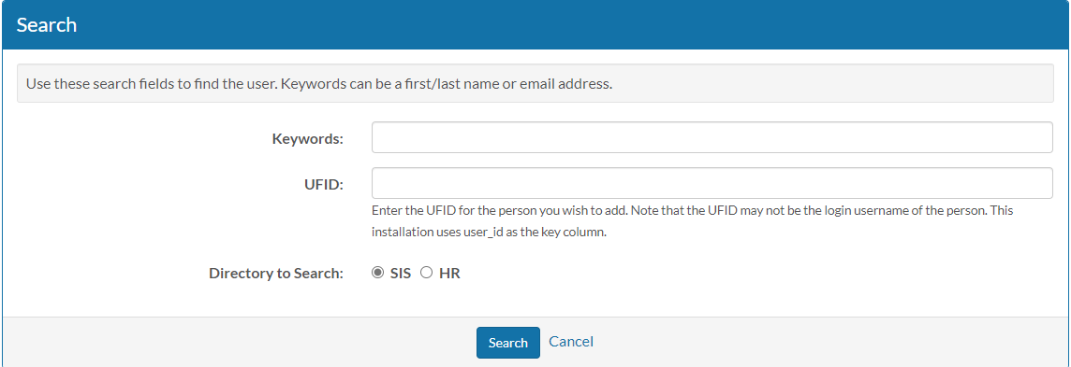
Selecting the Exchange Visitor
The following screen will come up once you login:
Please make sure the exchange visitor has their UFID made in UF’s system. If you just go to the New User section and put their email in without their UFID made, it will cause a non-integrated profile to generate. EVS cannot process a non-integrated profile.
Once you enter the exchange visitor’s UFID and click the search button, you will see the exchange visitor’s name and UF email come up in the search results. You will want to click the Register button

Slide 6
Entering Information
After you click on the register button, you will see a new page load up that has the visitor profile information like name and email address. Please put in the visitor’s personal email address in the CC email if you know they have not used their UF email address yet. The page will also be broken down by four different sections:
Initial DS-2019 Request for a J-1 Exchange Visitor
Academic Objective Information (J)
Financial Information (J)
Site of Activity Information
Each section have a certain questions that will need filled-in before you can submit the request.

Slide 7
Initial DS-2019 Request for a J-1 Exchange Visitor
RISC office approval
First, you will need to reach out to the RISC office to see what their process is to get their approval to invite your visitor.
Upload Documents
Second, you will be asked is to upload documents for the J1 visitor. These documents will need to be under one PDF document (merged together). If you try to upload a second document, it will override the previous one.
Upload Electronic Waybill – OPTIONAL!
DS2019s will be made available electronically to scholars, but if you would like us to physically mail DS2019s, you will need to upload a waybill/shipping label for EVS to ship the J1 visitor their DS-2019 to them. EVS will not send a DS-2019 through the USPS since EVS does not have the mail tracked. If you do not have a waybill/shipping label uploaded, the DS-2019 will be available online for them to download and print at home.

Slide 8
Initial DS-2019 Request for a J-1 Exchange Visitor Cont.
Please select the English proficiency confirmation for this request
There will be a drop-down selection for you to pick for the English Proficiency:
The exchange visitor will only need to do one of these selections.
Exempt - citizenship in one of the exempt countries (list is on our website)
English institution graduation - within the last 4 years only
English test score (IELTS, TOEFL, PTE, etc…) within the last 2 years
English3 – minimum 3.0 on English3 INTERVIEW (NOT TEST), within the last 2 years

Slide 9
Exempt - You will select exempt if the exchange visitor meets the English Exemption: http://www.ufic.ufl.edu/EVS/CountriesExemptfromEnglishProficiency.pdf
English Institution Graduation - If the exchange visitor went to an English institution that taught their courses in English and graduated. Only accepted if they graduate in the past 4 years. We do not accept current enrollment in a degree program as evidence of English proficiency.
English Test Score - If you are going to use an English test score that the exchange visitor took or you want them to take an English test. These tests can be International English Language Testing System (IELTS), Test of English as a Foreign Language internet-based test (TOEFL iBT), Pearson Tests of English (PTE) or Common European Framework (CEFR) taken within the last 2 years and meet our minimum scoring requirements.
English3 - If your department feels more comfortable to have the exchange visitor do an English3 interview, then you will select this one. Please submit their Englsih3 Interview score (minimum 3.0) in the combined pdf during the submission. The English3 Interview score can take up to 72 hours to upload in the system.

Slide 10
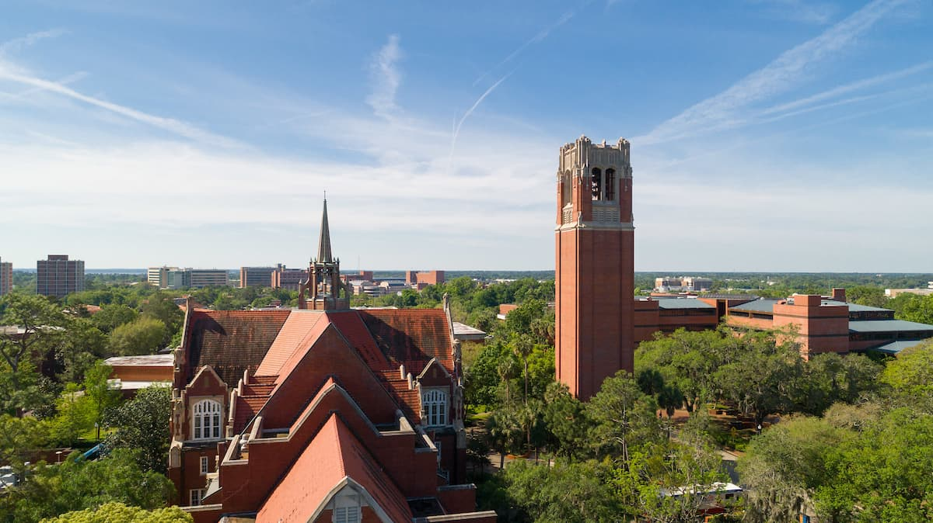
Initial DS-2019 Request for a J-1 Exchange Visitor Cont.
Start date of activity at UF – The exchange visitor’s start date of their program.
End date of activity at UF – The exchange visitor’s end date of their program.
Subject Field Code (CIP Code ONLY) – You will want to put the full CIP code, which is the classification of instructional program. For example if your exchange visitor’s CIP code is 01.1101 for Plant Sciences, General, then you will want to put the full six numbers. If you only put 01 in that will give EVS a wide option of different titles that will show up and not the Plant Science one. If you do not have the full CIP code number for the visitor, you can click on the link: https://nces.ed.gov/ipeds/cipcode/default.aspx?y=55
The link will send you to the site where you will need to search the name of what classification you want the exchange visitor to have and get the CIP number from that.

Slide 11
Initial DS-2019 Request for a J-1 Exchange Visitor Cont.
Is this a tenure-accruing position? Tenure positions are faculty positions (they are in a contract and cannot be fired)
Will the EV be employed by/visiting other U.S. institutions, during, before, or after UF visit? If UF is going to sponsor the exchange visitor but the exchange visitor is going to be at a different university in a different area, you would put yes. Other than that it’s usually a no for this question.
Does the exchange visitor have a medical degree? If the exchange visitor has a medical degree and you select yes, you will need to upload the No Patient Care or Contact letter.
Is the exchange visitor currently in J-1 status and transferring their sponsorship to UF? If the exchange visitor is a transfer-in, please make sure they have filled out their transfer-in form with UF. The transferring exchange visitor will not receive their DS-2019 until they complete the online check-in and do the EVS orientation.

Slide 12
Initial DS-2019 Request for a J-1 Exchange Visitor Cont.
Supervisor/Faculty Sponsor Name – You will enter the exchange visitor’s supervisor or faculty sponsor. If the supervisor or faculty sponsor changes during the exchange visitor’s J1 program, please make sure to submit a change of supervisor form in EVS system.
Supervisor/Faculty Sponsor Email – You will enter the supervisor or faculty sponsor email address.
Host Department Name – You will put the host department name here.
Your Name – Whoever is entering this information for the exchange visitor will put their name here. Usually the department admin or HR.
Your Email Address – The person entering the exchange visitor’s information will need to put their email address here.

Slide 13
Academic Objective Information
Position – You will select the visitor's position in their home country.
Exchange Visitor Category – In this section, you will need to select one of the three categories:
Research Scholar: An individual primarily conducting research, observing, or consulting in connection with a research program. A research scholar may also teach or lecture.
Professor: An individual primarily engaged in teaching, lecturing, observing or consulting. A professor may also conduct research. The exchange visitor cannot be a candidate for a tenure-accruing position.
Short Term Scholar: An individual primarily engaged in research, observing, teaching, consulting, training or lecturing for a period of 6 months or less.

Slide 14
Academic Objective Information Cont.
Subject/Field of Study Description – You do not need to fill this section out.
Foreign Degree Level Remarks – This section is only filled out if the exchange visitor is a student intern
Foreign Field of Study Remarks - This section is only filled out if the exchange visitor is a student intern
Remarks – You can put any remarks in this section. If you have no remarks, you can leave it blank.

Slide 15
Financial Information
In this section you will only need to fill out the section that says:
Received US Government Funding. You will put no for this question.
You do not need to input the funding amount in any of the other sections because EVS will calculate the total amount the exchange visitor will have based off the proof of funding document.
EVS prefers the proof of funding to be salary amount and not an hourly amount if your department is providing the funding to the exchange visitor.

Slide 16
Site of Activity Information
Address Line 1 – Enter the location the exchange visitor will be doing their activity at. This must be the physical address. No on-campus halls or P.O Boxes.
Address Line 2 – Please put the UF College in this section. Which would be UF College of Medicine, UF College of Engineering, etc.
City - The city location of the site of activity.
State – The state location of the site of activity.
Site of Activity Name – You will want to put the host department in this field. EVS would like it to be inputted as Dept. of (then whatever your department is). You do not need to put the UF in the beginning.
Site ID – Please leave this field blank.

Slide 17
Site of Activity Information Cont.
Primary Site of Activity? – This should be mark as Yes. If you have another site of activity, the visitor will be doing their research at, please email EVS and let us know. There is an additional form that will need to be completed for more than one site of activity.
New Site of Activity Name – You don’t need to put anything in this section.
Remarks – If there’s any remarks you would like to put, you can put it in here.

Slide 18
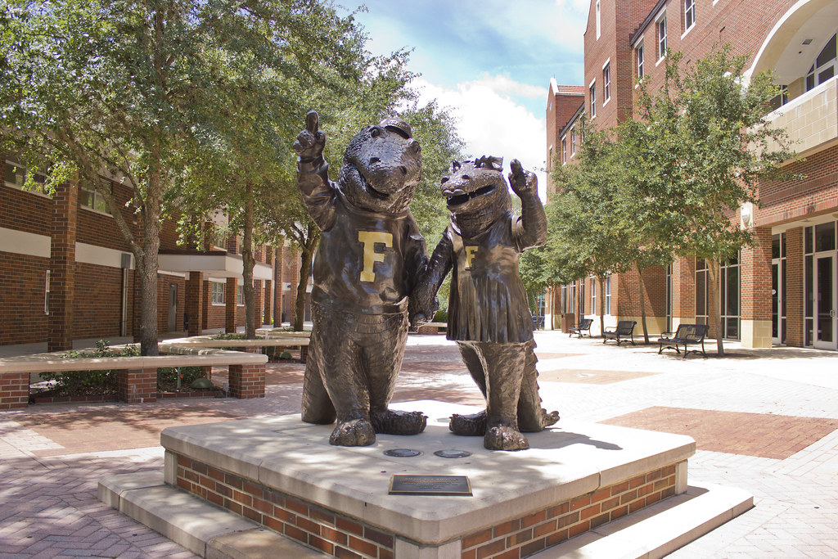
Questions?

